Slide 1
LECTURE 4 Subtraction with Complements (1’s and 2’s)

Slide 2
Subtraction with Complements
The direct method of subtraction taught in elementary schools uses the borrow concept.
In this method, we borrow a 1 from a higher significant position when the minuend digit is smaller than the subtrahend digit.
The method works well when people perform subtraction with paper and pencil.
However, when subtraction is implemented with digital hardware, the method is less efficient than the method that uses complements.

Slide 3
Subtraction of two n‐digit unsigned numbers M - N in base r
The subtraction of two n‐digit unsigned numbers M - N in base r can be done as follows:
1. Add the minuend M to the r’s complement of the subtrahend N. Mathematically,
M + (r^{n} - N) = M - N + r^{n}.
2. If M ≥ N, the sum will produce an end carry r^{n}, which can be discarded; what is left is the result M - N.

Slide 4
Subtraction of two n‐digit unsigned numbers M - N in base r
3. If M ˂ N, the sum does not produce an end carry and is equal to r^{n} - (N - M), which is the r’s complement of (N - M).
To obtain the answer in a familiar form, take the r’s complement of the sum and place a negative sign in front.

Slide 5
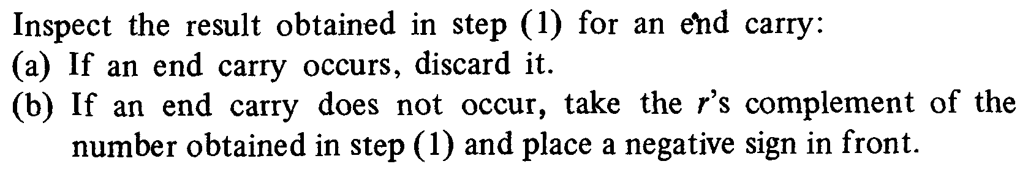
Subtraction of two n‐digit unsigned numbers M - N in base r
Both numbers must have the same number of digits
1.Calculate the r’s complement of the subtrahend N. Add the minuend M to the r’s complement of the subtrahend N.

Slide 6
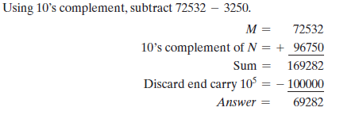
Subtraction Using 10’s complement

Slide 7
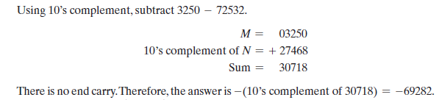
Subtraction Using 10’s complement

Slide 8
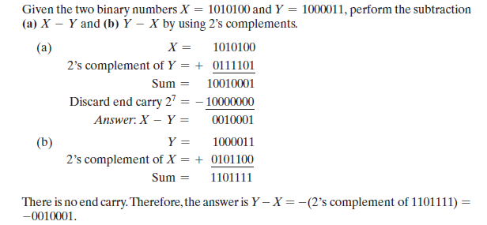
Subtraction Using 2’s complement

Slide 9
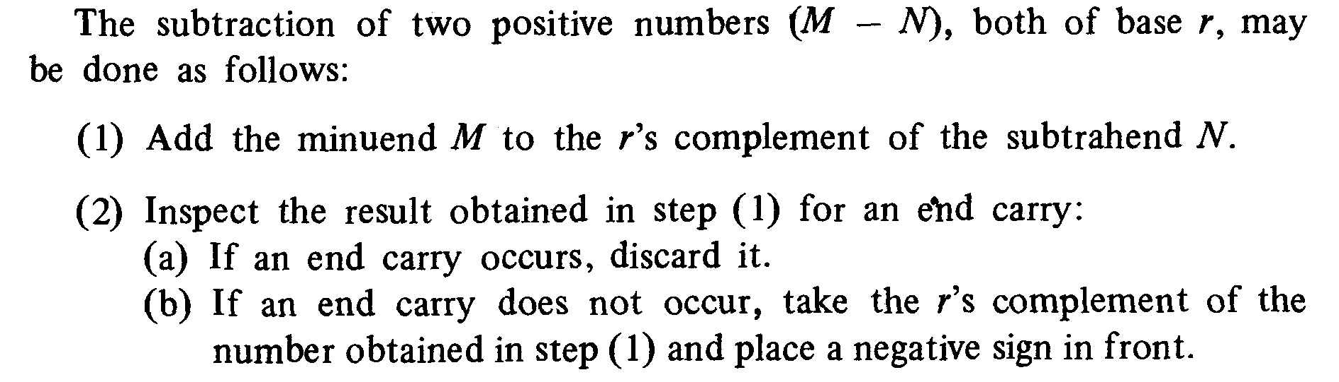
Subtraction with r’s Complement

Slide 10
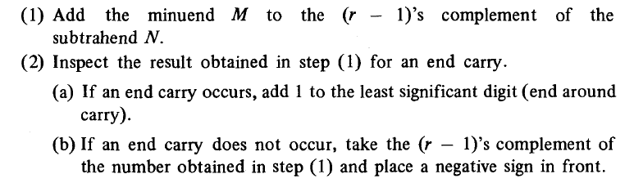
Subtraction with (r-1)’s Complement
Both numbers must have the same number of digits

Slide 11
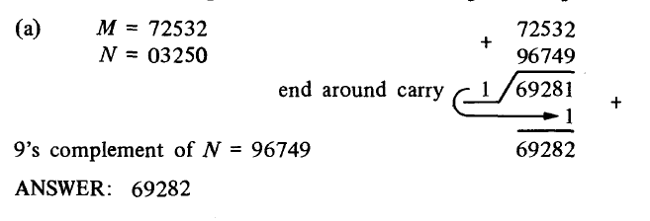
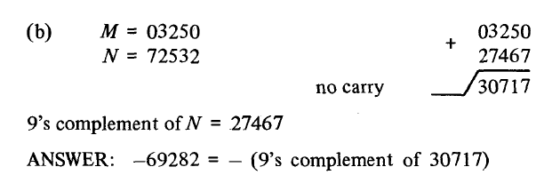
Subtraction Using 9’s complement

Slide 12
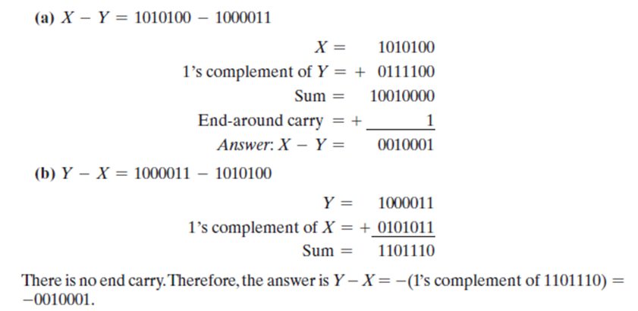
Subtraction Using 1’s complement

Slide 13
Some additional problems:
Perform subtraction on the given unsigned numbers using the 10’s and 9’s complement of the subtrahend. Where the result should be negative, find its 10’s/9’s complement and affix a minus sign. Verify your answers.
(a) 4,637 - 2,579 (b) 125 - 1,800
(c) 2,043 - 4,361 (d) 1,631 – 745

Slide 14
Additional Problems:
Perform subtraction on the given unsigned binary numbers using the 2’s and 1’s complement of the subtrahend. Where the result should be negative, find its 2’s/1’s complement and affix a minus sign.
(a) 10011 - 10010 (b) 100010 - 100110
(c) 1001 - 110101 (d) 101000 - 10101

